Slide 1

How to gain access to opportunities?
Notes:
Think about the last time you acted as a consultant in the broad sense - i.e. tried to influence someone to solve a problem where you did not have direct control. How did that problem identification come about? They might have asked for help - but not unlikely that you noticed, and first had to convince them that there was a problem.

Slide 2


Where Do Opportunities Come From?
Problem Seeks Solution
Solution Seeks Problem
Problem Co-Production
The traditional view. Client has a problem, searches for someone who can help, finds a consultant.
Consultants develop approaches—Six Sigma, digital transformation, agile methodology—and then convince clients these are relevant.
The problem isn't fully defined. Consultant and client work together on articulation, accentuation, adaptation, negotiation.
Demand-led, rational, straightforward. The client drives the process from start to finish.
The solution exists before the problem is identified. Controversial "best-practice marketing."
Who has control? How is it exercised?
Sturdy (2018) suggests this is a false dichotomy; co-production is very common.
Also, phases are intertwined: How you frame the problem shapes what solutions look viable;
the solutions you know about shape how you frame the problem.
Notes:
In co-production: Negotiation on the side of the client - between senior managers and those closer to the problem - but also with procurement department that might be unwilling to pay for co-production.
Problem framing – also e.g. related to assumed values – motivation or skill issue?

Slide 3



Clients vs. Customers (Schein)
Clients
Customers
Want to work with you to improve a situation. Open to exploring whether their initial framing is right. Co-production works here.
(Think they) already know what they want; they just need you to deliver it. Fixed specification without exploration.
Closed to alternative framings
Open to diagnosis
Pre-determined solution
Value joint problem definition
Execution-focused
Flexible on approach
Have you generally worked for clients or customers so far? What do you prefer?

Slide 4
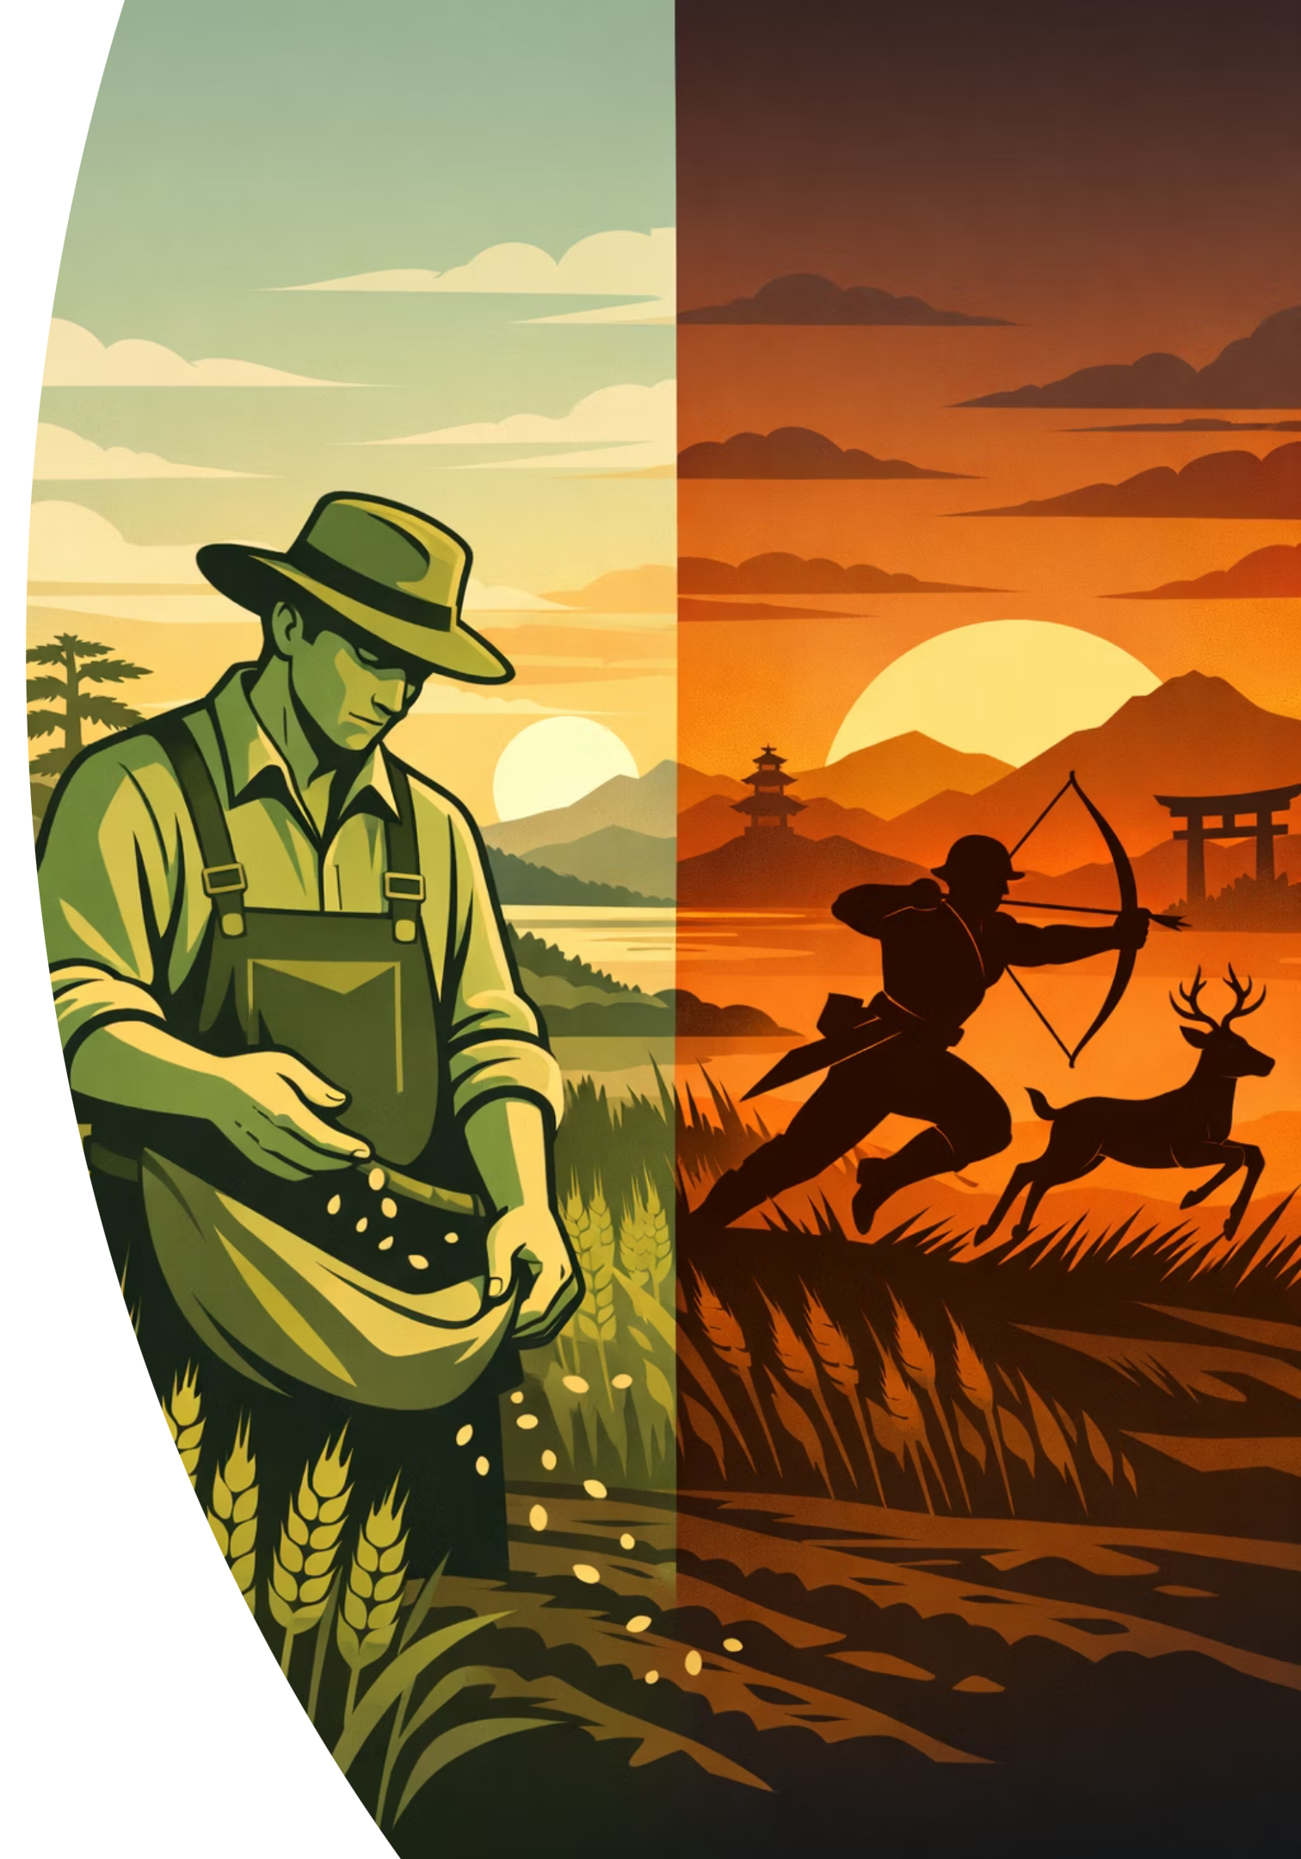
Farming vs. Hunting
Two approaches to getting work.
Farming
Hunting
You plant seeds and cultivate relationships over time. Eventually, clients come to you.
You go out and pursue opportunities directly.
You identify a prospect, make contact, pitch your services.
They've read your articles, seen your presentations, heard about you from someone they trust.
Shorter-term active pursuit of specific opportunities
Long-term investment in reputation building.
Most successful consultancies blend both.
Given the need for reputation, farming matters.

Slide 5
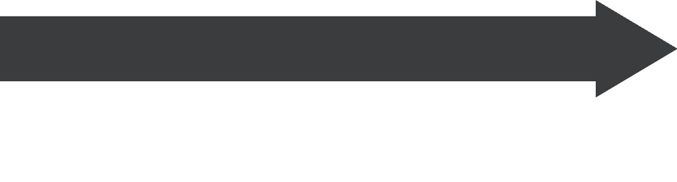

The Pyramid of Trust
Williams (2022) suggests that most consultancies fail to do marketing but pursue a "hope strategy."
Systematic alternative: the pyramid of trust that moves prospects through three stages deliberately
Generate Leads
Build Trust
"Informed" audiences who are ready. Intimate interactions: webinars, executive roundtables, one-to-one conversations. Moving from one-to-many to one-to-one.
Get Known
"Afflicted" audiences who recognise challenges but aren't ready to buy. Deeper engagement: newsletters, blogs, lead magnets demonstrating genuine expertise.
"Oblivious" audiences who don't know you exist. Broad channels: LinkedIn, networking events, thought leadership. Getting on their radar.
The framework's value lies in linking these activities into an integrated process,
not treating them as disconnected marketing tactics. Each stage systematically feeds the next.

Slide 6


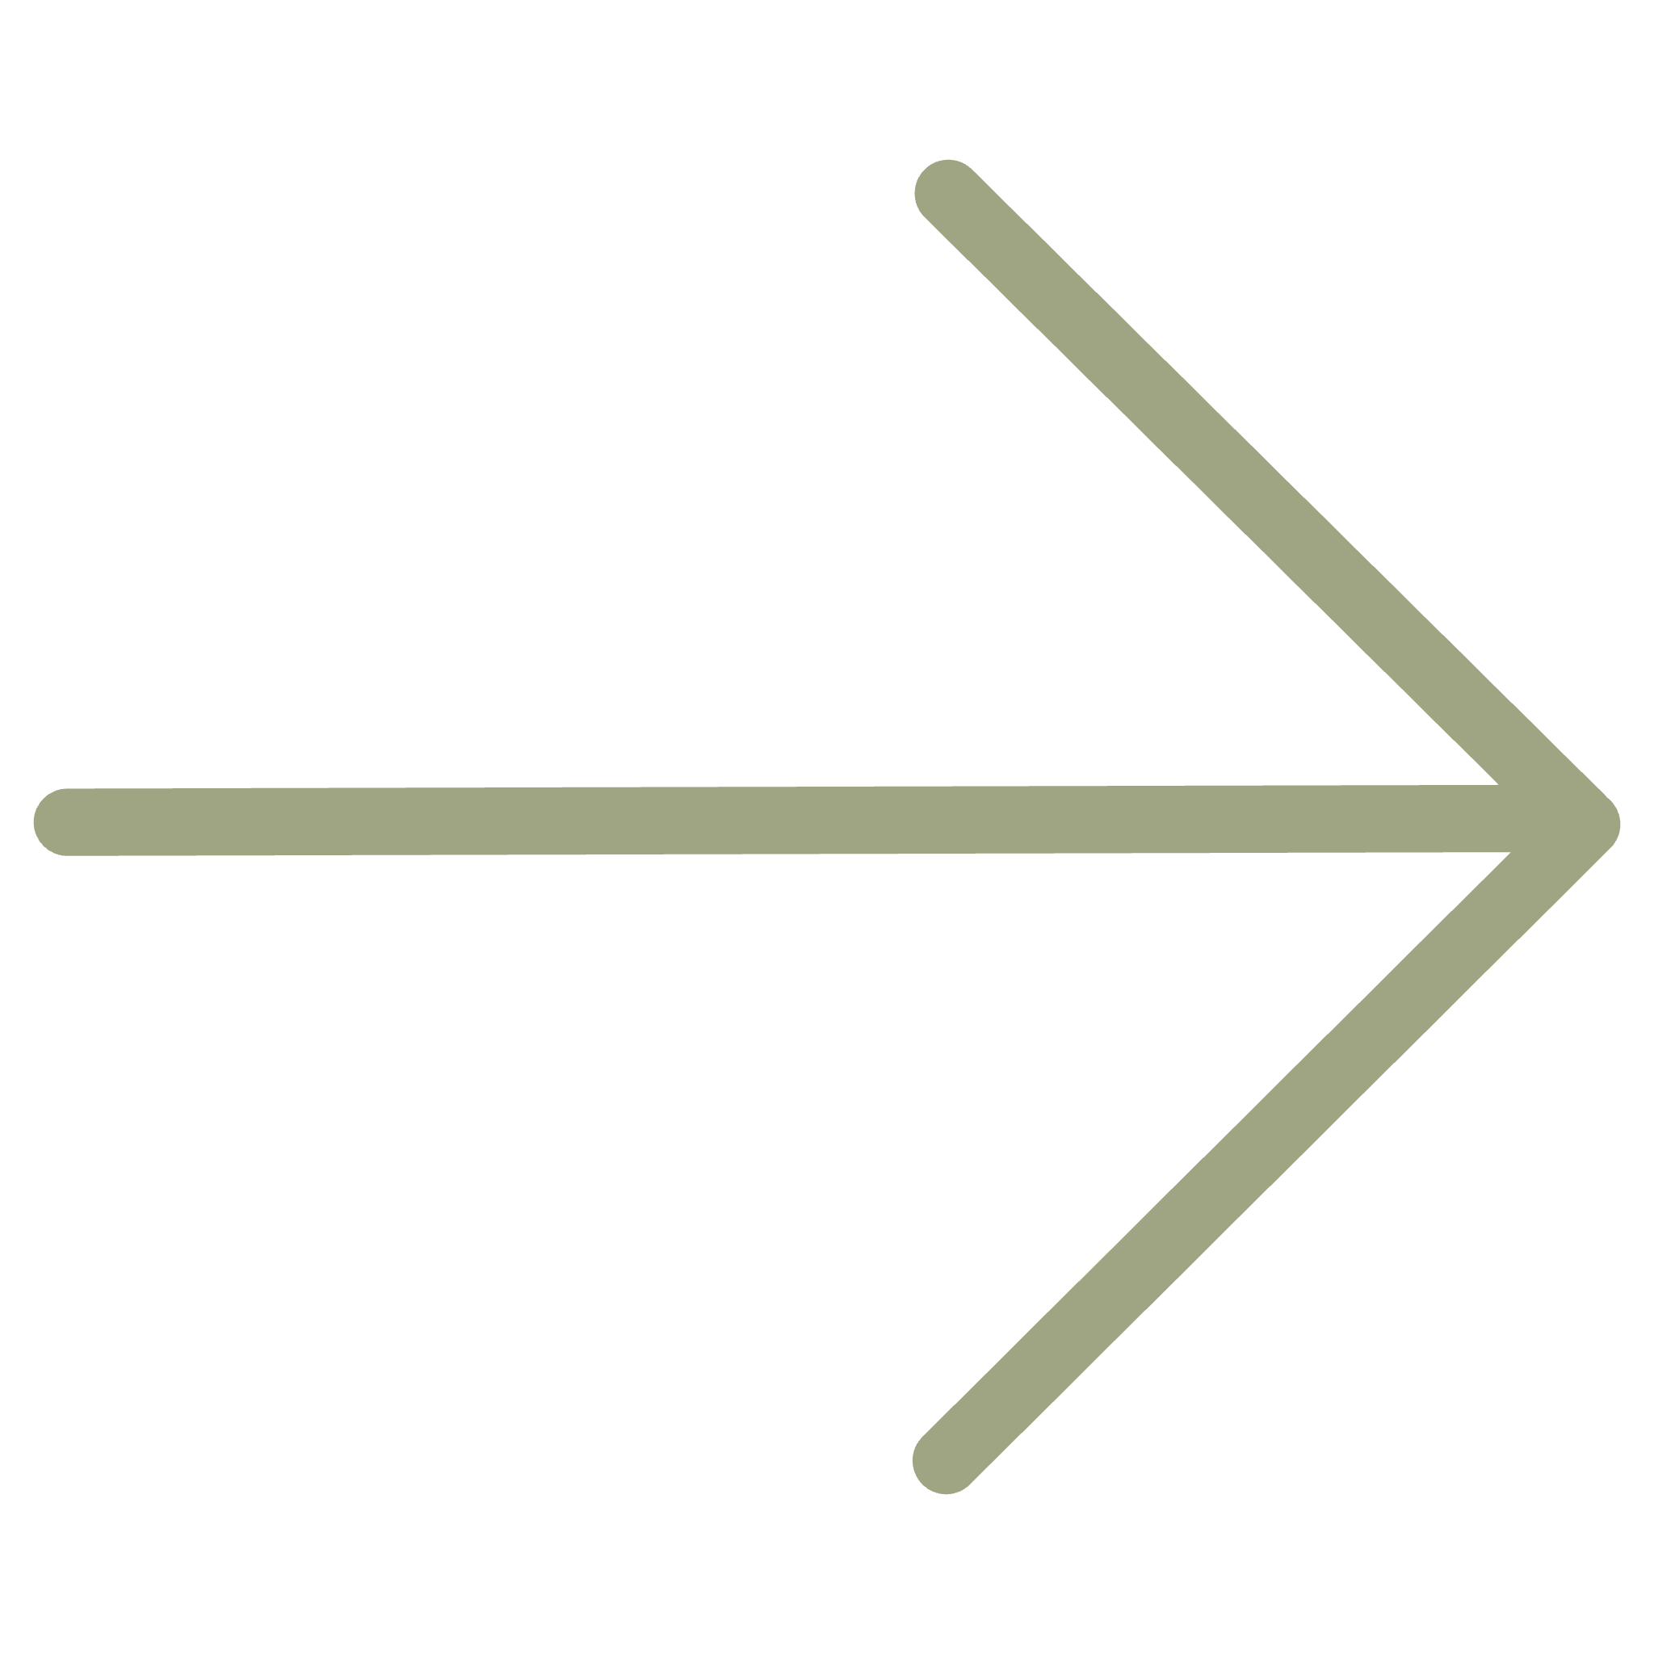
Your reflection
How did you find work so far, as a consultant or otherwise? Farming, hunting, or both?
How do you feel about putting yourself out there,
about personal branding?
COMING UP NEXT
Effective Contracting
Notes:
It's not always "client has problem, calls consultant." Sometimes consultants create the problem. We'll look at farming versus hunting, and a framework called the Pyramid of Trust.

